Slide 1
Demo Overview
“Live” example of CP1 and CP2 together
Show baseline on real device
Run “Baseline Stage A” in emulated environment
Run “Challenge Stage” with a perturbed environment and mission requirements
Keep the ‘real’ devices alive

Slide 2
Demo Notional Scenario
Baseline application assumes GPS
A new set of changes to requirements comes in
Must work in a GPS-denied environment
Must send images
Has severely restricted bandwidth

Slide 3
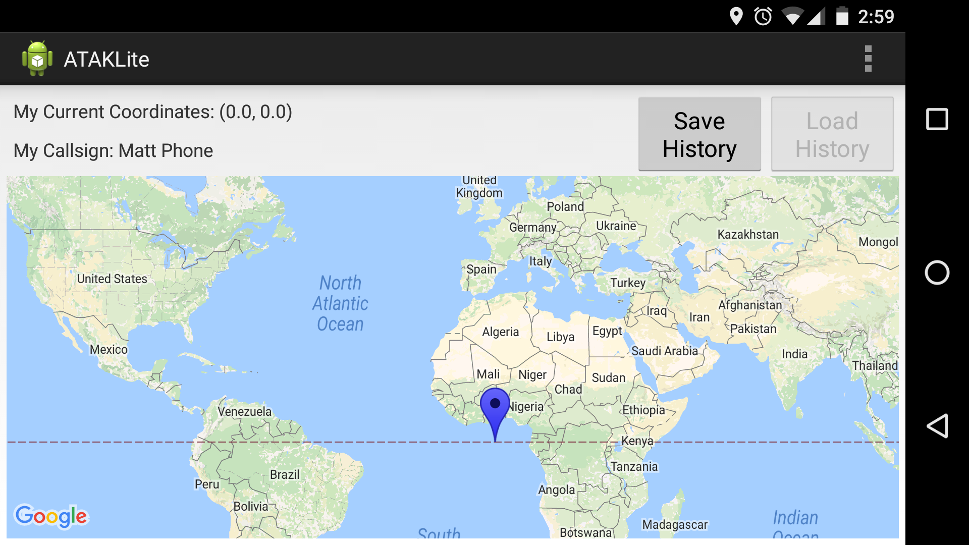
Baseline application

Slide 4
Linkage to Evaluation
TA4 interface is reasonably complete
REST/programmatic interface for LL
Browser display for demo/workshop purposes
Android Emulation
Scenario execution infrastructure implemented as part of Test Adapter can spin up multiple independent Android Emulators
“Simulated” app fully interoperable with real devices

Slide 5
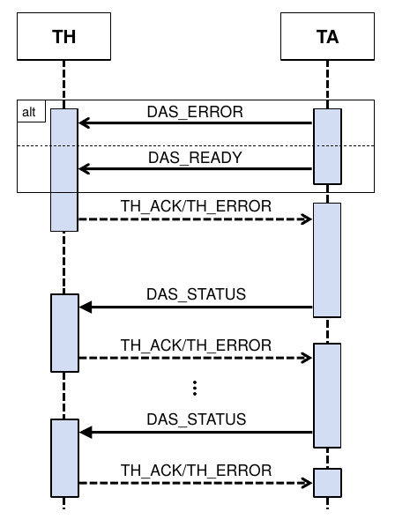
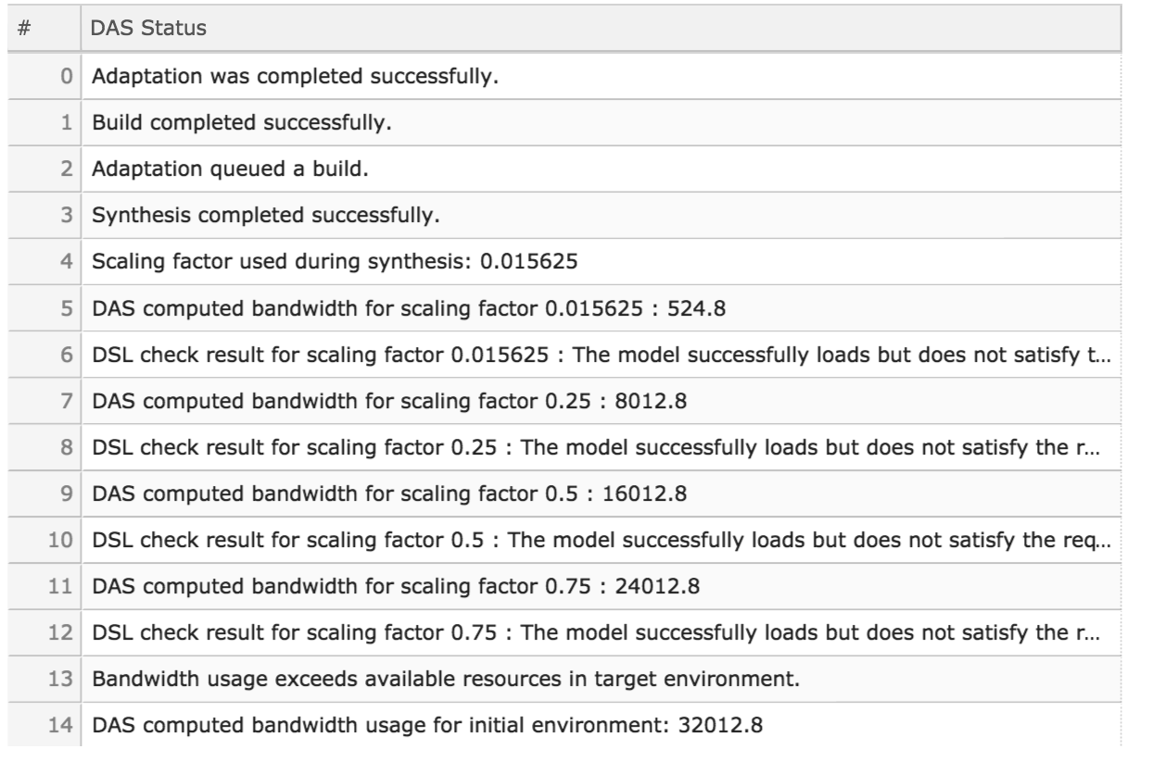
TA4 interface: DAS Status

Slide 6
Intent Validation
After scenario execution, log analysis is used to evaluate intent tests.
Fixed set of tests
Based on scenario, specific tests will be marked as ‘required’
Based on scenario tests will be required to pass or fail
E.g. bluetooth-gps test should fail if GPS satellites are unavailable

Slide 7
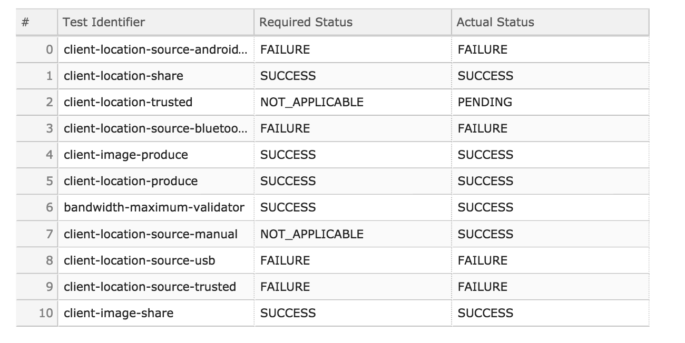
TA4 interface: Intent Validation

